Slide 1
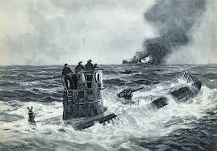

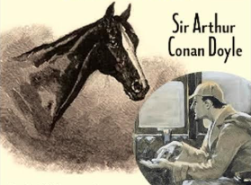
Detecting the Undetectable: silent Transmitters and the Dogs that didn’t Bark
Traffic Analysis in the Battle of the Atlantic
John Magill ISMOR 2025
Notes:
1
1

Slide 2
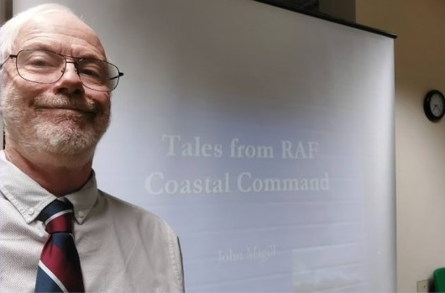

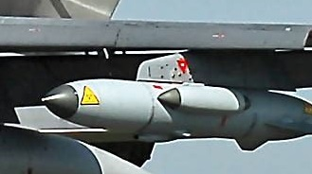
Who am I
long… career in Aerospace and Defence
worked in Systems Engineering and OR/OA for 40 years
hold half a degree in OR
started out as a real engineer, can drop things on your toes
john.magill@cantab.net
Notes:
2

Slide 3



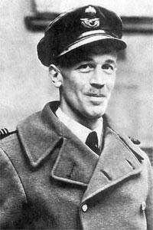
Why am I so interested
70’s revelations on TV and print
  met Prof RV Jones at College
Started my career on Space & Defence Systems at Marconi Stanmore
Distinguished relative was in RAF Coastal Command
  flew Harry Hopkins to meet Stalin July 1941
      via North Cape to Archangel
  Round-the-world and Arctic flights
  AOC Malta
  Air Vice Marshal David McKinley
Notes:
3
He started in coastal comm – may have moved out.
Harry hopkins – roosevelts rep - already dying of cancer
Had been in London during blitz and now wanted to size up stalin, after barbarossa – eg lend lease
Flew Invergordon to Archangel, (slow) Catalina 125 mph – at mercy of LR fighters Ju 88, but resolved to dive to sea level if attacked (maybe to avoid being attacked from below)
Also Xmas island tests
Left aged 54, reported spat re TSR2, he was against.
Harry

Slide 4
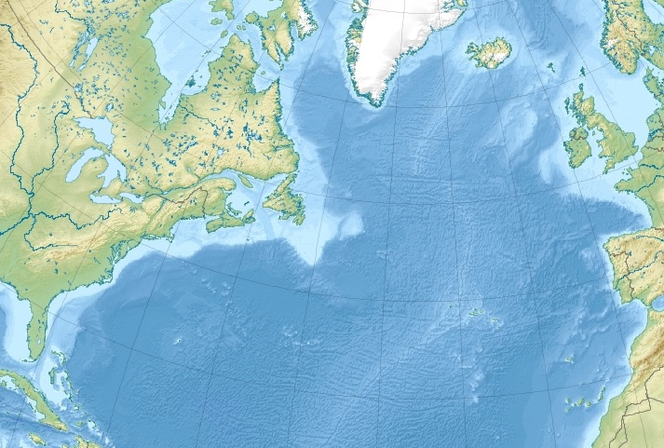
Scenario: Battle of the Atlantic
Convoys
Wolf packs
Tactics
Air Cover
Code breaking
HFDF
Wargaming
Wireless Intercepts
.
Notes:
4
This audience wont need to be told…
But, epoch – early days, Blackettonly just at CoaCom
U bt as submersibles – good tactic is to make em dive repeatedly

Slide 5


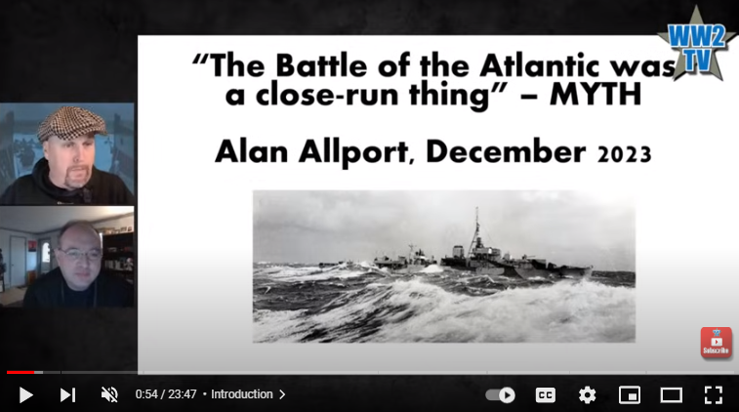
Battle of the Atlantic: 80+ years on
Notes:
5
This audience wont need to be told…
But, epoch – early days, Blackettonly just at CoaCom
U bt as submersibles – good tactic is to make em dive repeatedly

Slide 6
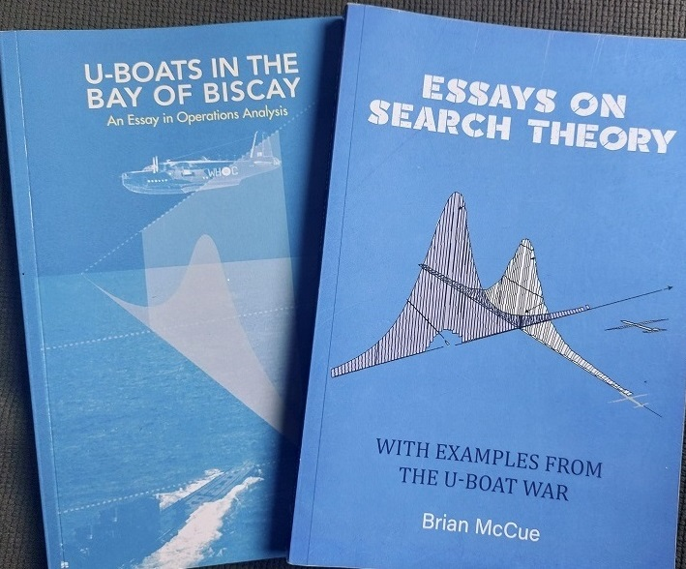

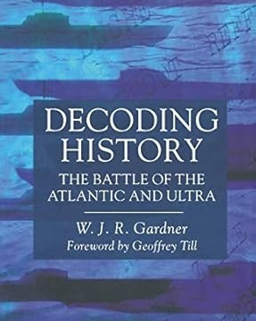
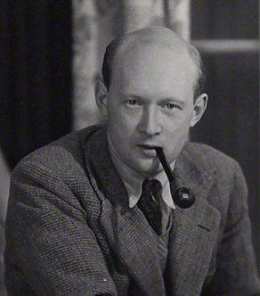
Source material
Notes:
6
Zoologist/ geologist – polymath, understand variation
Books difficult to get hold of, but I managed it
Other book impossible – not been written printed yet
OR Soc project, maybe re-energise?
Also a pt3 proposed – OR in the post cold war, COIN etc.

Slide 7
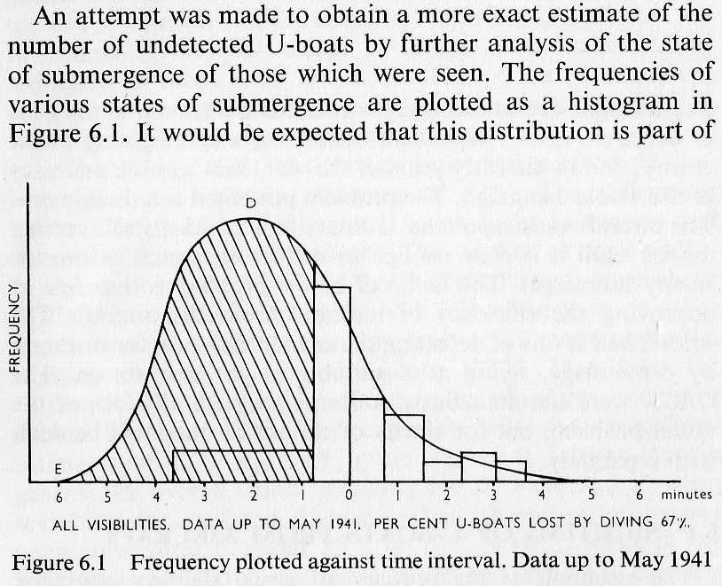
Waddington: Un-seen U-boats
U-boat sees aircraft first
U-boat sees aircraft first and is diving when seen
U-boat sees aircraft first and dives before being seen
Aircraft sees U-boat first
.
Diving swirl ?
Notes:
7

Slide 8
Traffic Analysis
Traffic Analysis concerns itself with everything about the intercepted message other than the meaning of the text…
“…Traffic Analysis is probably the most difficult area of SIGINT to grasp, and certainly the most difficult to evaluate.
In practical terms, however, it contributed greatly to assessment of U-boat numbers at sea…
…Traffic Analysis and Ultra enjoyed a symbiotic relationship”
WJR Gardner p131
(Former Naval Officer and historian)
Notes:
8
8

Slide 9
U-boat message intercepts
U-222
U-111
U-333
U-444
Notes:
Assuming U boat dives when sees aircraft: 25-45s

Slide 10
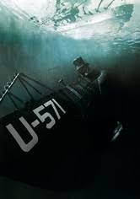
Traffic Analysis
Identify the sender/ number of distinct senders
  We can use techniques to identify/distinguish the originating U boat
    Radio Finger-Printing (RFP – distinct to radio equipment)
    TINA (Morse code “fist” – distinct to radio operator)
    Direction Finding (HF DF)
Then
  we can tell how many different U boats we have intercepted a given number of signals from
During Operations, U-boats were very reluctant
to reveal their U-number!
Notes:
10
10

Slide 11
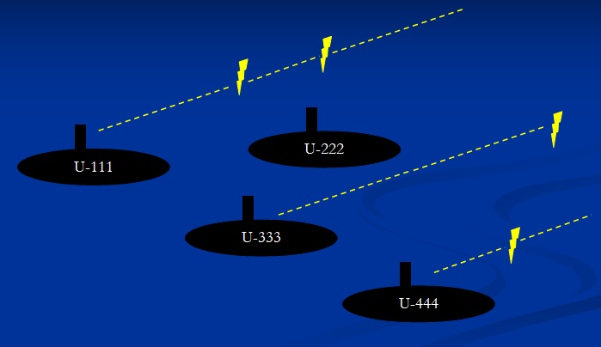
U-boat message intercepts
No. U-boats
3
2
U-444
1
U-222
U-333
U-111
0
0
1
2
No. broadcasts detected
Notes:
11
Assuming U boat dives when sees aircraft: 25-45s

Slide 12
Estimating the number of “unheard” U boats
Intercepted signals from U boats
  A number of signals are intercepted from U-boats
  Having identified distinct senders, we can tell how many different U boats we have intercepted a given number of signals from
  But we can’t tell how many we DIDN’T hear from… and might be lurking out there…
Or maybe we can, by making a raft of assumptions…
  Randomness, many trials, constant probabilities… Poisson-ness
Notes:
12
12

Slide 13
Plot how many U-boats are heard so many times
?
need to
“estimate the Zero Class of a Truncated Poisson distribution”
Notes:
13
13

Slide 14
Knowns, Unknowns and Assumptions
We know:
  How many messages were intercepted (m) (290 in this example)
  How many different U-boats we heard from (97 in this example)
We don’t know:
  How many U-boats we didn’t hear from: (U0)
  => how many U-boats are out there in total: (U)
  => what the actual (average) message rate is: (m/U)
We assume:
  Constant message rate over time and over U-boats
  Poisson-ness
  => Probability of hearing n times from a U-boat is (m/U)^{^n} exp^{(-m/U)} /n!
Notes:
14
14

Slide 15


Estimation
Notes:
15
15

Slide 16
Maximum Likelihood Estimation
“…the Maximum Likelihood Estimate is the value that leads to the greatest probability of the data actually occurring…
…it is not the value that the observed data make most probable”
McCue
(necessarily)
^
So, we treat the outcome as fixed and see how its probability varies with the value of the parameter. This is called the Likelihood of the parameter. (It is not a pdf and doesn’t have to sum to unity!)
Notes:
16
16

Slide 17
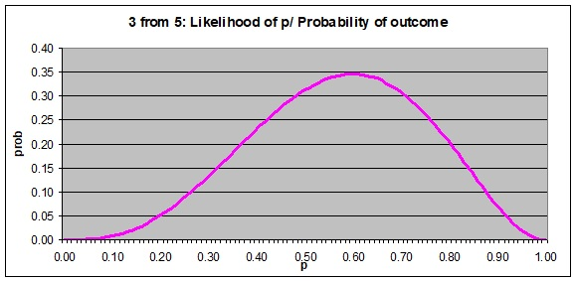
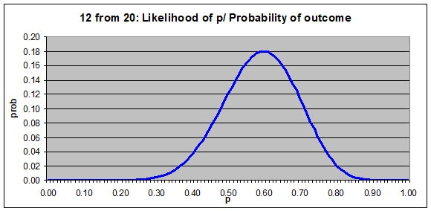
Likelihoods
Fire 5 missiles at target and 3 hit: estimate p(hit)
Fire 20 missiles at target and 12 hit: estimate p(hit)
Notes:
17
17

Slide 18
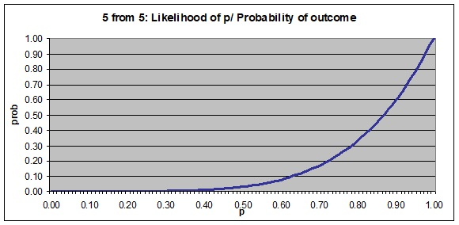
Likelihoods
Fire 5 missiles at target and 5 hit: estimate p(hit)
Maximum Likelihood estimate in this case would be 1…
Maybe need to look at Mean Likelihood…
…or some “prior” information
Notes:
18
18

Slide 19
On estimating the number of “unheard” U boats
?
So, can be confident that not very many went unheard…
Notes:
19
19

Slide 20
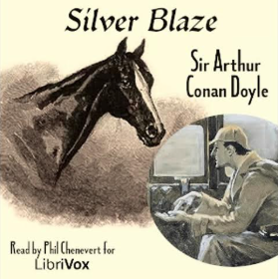
Dogs that didn’t bark
Notes:
20
20

Slide 21
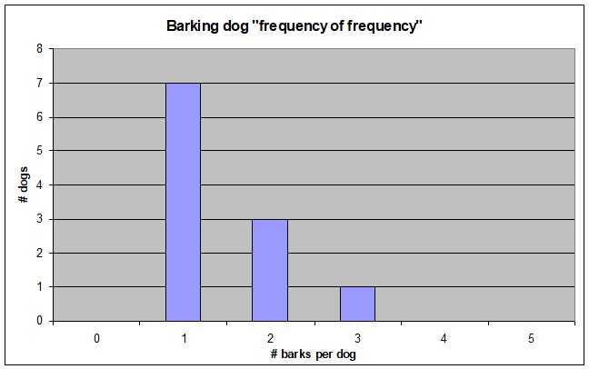











…a number of “unheard” dogs
?
Notes:
21
21

Slide 22
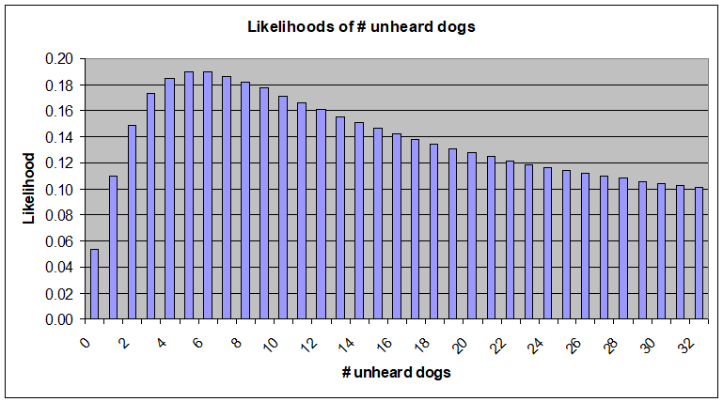
…a number of “unheard” dogs
With fewer data points, Likelihood function has a very long tail
(remember it doesn’t have to sum to 1)
“zero class” & “bark rate” confounding – there could be a veritable “plague of frogs”
Notes:
22
22

Slide 23
Conclusions
“…a tidy example of the art of proceeding from the known to the unknown: the very essence of intelligence analysis”
McCue
(know we)
(know we)
What we know
What we don’t know
^
^
(don’t know we)
(don’t know we)
What we know
What we don’t know
^
^
Notes:
23
23

Slide 24
End
Notes:
24
24

